Slide 1
SMC mould cases
MDC
compression mould
compsite mould
Let's get started on your new project!

Slide 2
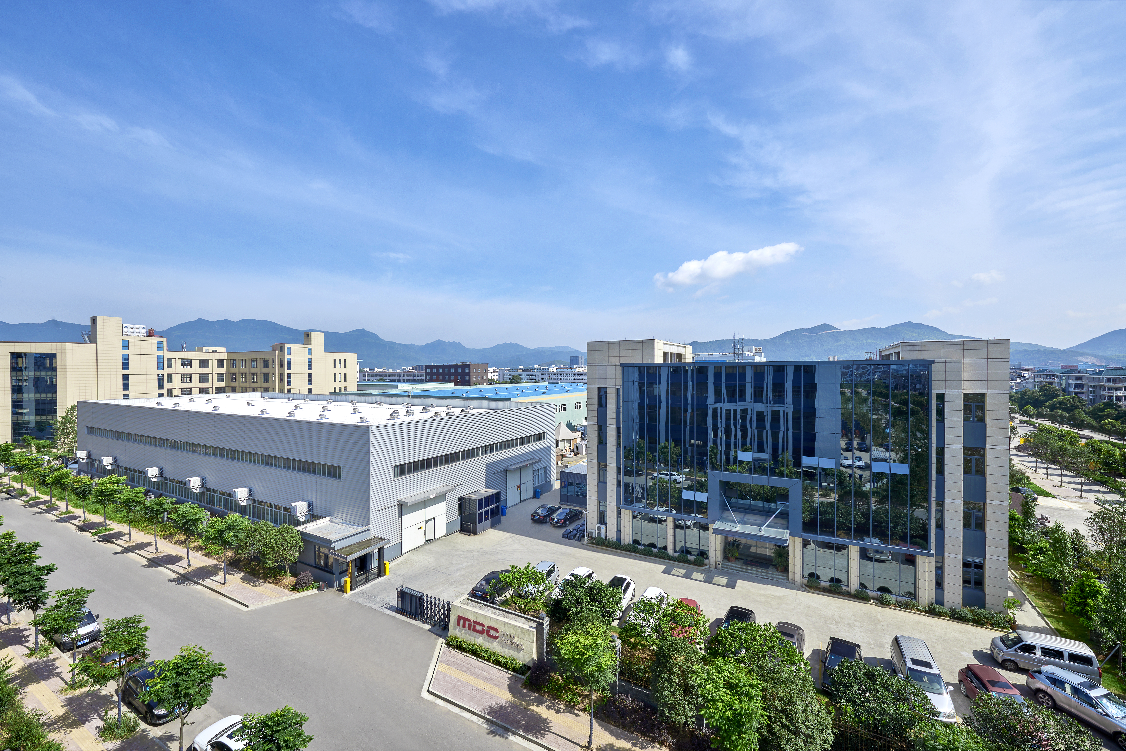
MDC
Since establishment in 1997, MDC Mould was the development and manufacture of world class compression mould. The experience of mould design and manufacture spans many industries including Sanitary&Kitchenware, Automotive, Electrical, Transportation, Bathroom, etc.
As a result of ongoing development, the highly skilled project management, designers&technicians , Engineers enables us for the success of every project whatever the large or small mould it maybe.

Slide 3
SMC AUTOMOTIVE MOULD
MDC

Slide 4
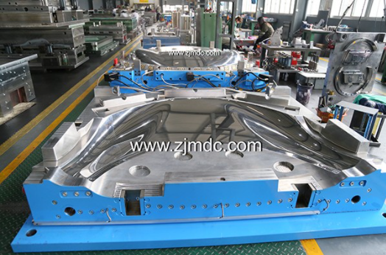
MDC
SMC ENGINE HOOD MOLD
With SMC mould widely application in heavy truck industry, our customer and MDC were proposed CAT to use SMC material instead of metal material due to weight reduction, corrossion resistance, etc. The advantage of SMC mould was finally accepted by end customer, and they're thinking about replacing all the visible metal parts , such as roof, side panels, air ducts, etc ,after approval its property.
MDC Mould, as a professional SMC Mold maker in china, is honor to develop SMC engine hood mold for our end customers, such as CAT, John Deere, CNH, AGCO, Escorts, etc.

Slide 5
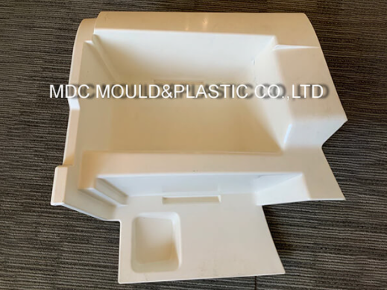
SMC FOOT PLATE MOULD
MDC
MDC manufactures automotive foot plate moulds, we provide plate moulding and surface treatment services. SMC mould has the advantages of high strength, corrosion resistance, dimensional stability, aging resistance, smooth and flat surface, etc. It is especially suitable for pressing the plate components of cars, trucks, agricultural vehicles and other vehicles.
MDC mould has a large number of complete automotive mould processing equipment, advanced imported axis CNC machine tools, which are specially suitable for processing and manufacturing SMC foot plate mould. We pay attention to the processing size of the mould. After the mould is processed, the three-axis size inspection and verification will be carried out. Each component will be issued a size inspection report.

Slide 6
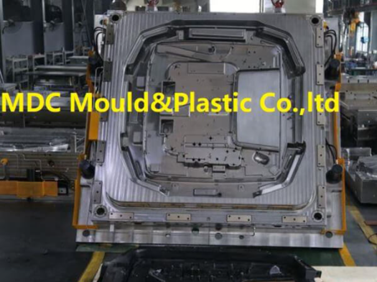
SMC BOTTOM COVER MOULD
MDC
The auto bottom cover refers to a guard plate installed at the bottom of the car engine. The main function is to prevent the bottom of the engine from being damaged when the car is driving on a bumpy road.
SMC is a lightweight solution with the most cost advantage to replace metal to make car bottom cover. MDC has a wealth of experience in the mass production application of A-level surface SMC bottom cover.
MDC mould provides SMC bottom cover mould. We directly press SMC, GMT, LFT-D and other new composite materials into automotive bottom cover through mould pressing, and produce relatively lighter and stronger bottom cover parts.

Slide 7
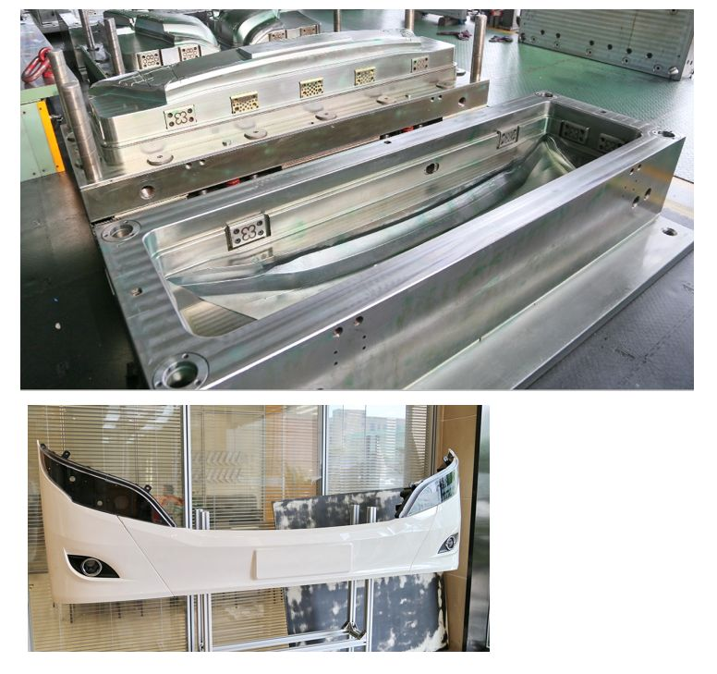
SMC BUMPER MOULD
MDC
With the continuous reform of the automobile industry, more and more automobile bumpers are made of SMC glass fiber reinforced plastic. One-time molding SMC bumper does not require secondary processing, high precision of pressing effect, short molding cycle, strong and stable, resulting in beautiful and safe. SMC compression mould are more suitable for automotive use than injection moulds. SMC has better collision resistance than plastic, and at the same time, it has a long service life.
MDC mould specializes in the production of various types of SMC bumper moulds and their auxiliary parts. MDC supplies SMC bumper mould to global automakers and has extensive experience in bumper moulding. MDC Mould has been providing SMC front bumper mould and SMC rear bumper mould for different automakers. MDC Mould continuously optimizes the design of bumper mould and introduces advanced technology of automotive mould to meet the customer's surface requirements and productivity requirements for bumper moulds.

Slide 8
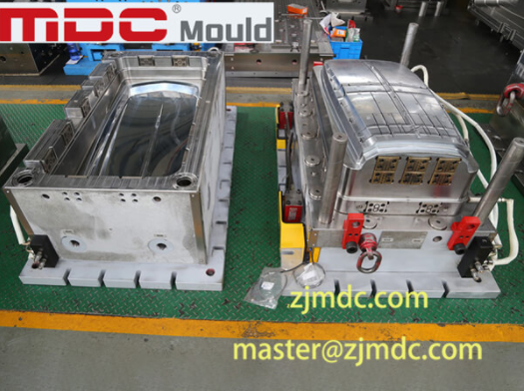
SMC TOP PANEL MOULD
MDC
As we all know, One of the advantages of compression moulding is used to form large flat-panel products. Therefore, for the front panel, top panel and other automotive panel components, MDC mould has already cooperated with many domestic and foreign automotive manufacturers.
MDC has carried out the SMC top panel mould project for various types of automotive. At the same time, MDC provides support from conceptual design to mould manufacturing. With the 4000T punching machine, MDC can meet customers' trial needs for parts ranging in size from 3,500x3,200MM.

Slide 9
SMC ELECTRICAL MOULD
MDC

Slide 10
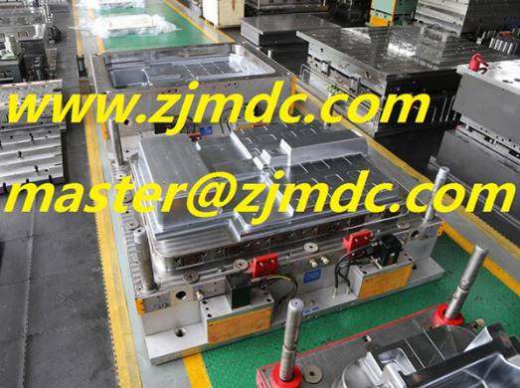
SMC METER BOX MOULD
MDC
SMC electric meter box mould requires a special composite material, which consists of two parts: Matrix-polyester resin and reinforcement materials. The new SMC composite meter box is specially used for power distribution network in outdoor public places, especially suitable for industrial and mining enterprises, residential communities and high-rise buildings and other power supply network terminals. It has good insulation, environmental protection, flame retardance, corrosion resistance, and longer life than metal materials. It can effectively solve the problem of easy electric shock caused by the low voltage distribution box made of iron shell installed in the community.

Slide 11
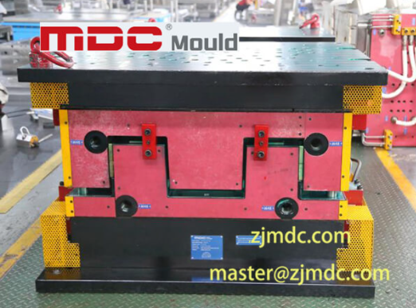
SMC CONNECTION BOX MOLD
MDC
The SMC connection box is used to protect the wiring and avoid electric leakage or short circuit. The junction box shell is generally made of plastic. Due to long-term outdoor use, the outdoor junction box shell made of plastic is prone to aging. Therefore, we use SMC to manufacture junction box products. SMC junction box has the characteristics of good corrosion resistance, wide temperature range, high mechanical strength, complete insulation and non-conductivity, and long service life.
The junction box mold uses SMC to produce the required junction box products through a compression moulding process. The material ratio of SMC can be adjusted to meet the needs of various harsh environments and places in outdoor projects.

Slide 12
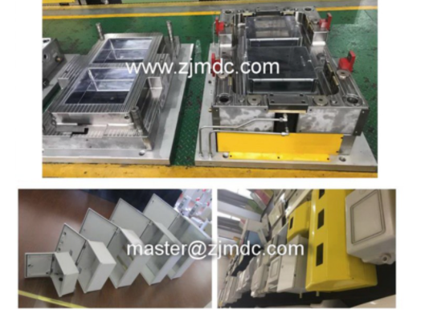
SMC DISTRIBUTION BOX MOLD
MDC
SMC distribution box mold manufacturer, Dacheng has many years of experience in molding technology and processing machinery, provides mold design and customization services, and can manufacture and provide high-quality SMC distribution box molds and products. SMC distribution box is molded by distribution box mould, SMC unsaturated polyester resin. It solves the problems that wooden meter boxes, steel meter boxes and plastic meter boxes are easy to age, rust, poor insulation performance, poor cold resistance, poor fire resistance, and short service life. It is suitable for housing construction and civil power transformation. Suitable for multiple houses, single house or cross house installation, easy construction, hidden wiring and rain protection.

Slide 13
SMC INDUSTRIAL MOULD
MDC

Slide 14
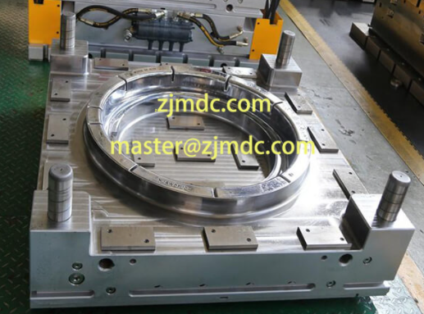
SMC MANHOLE COVER MOULD
MDC
Compression Mould process produces high strength, complex manhole cover parts in a wide variety of sizes. The manhole cover material charge is manually or robotically placed in manhole cover mould; the heated mould halves are closed, pressure can be available applied from 500T till 4000T at MDC workshop, cycle time ranges from one to five minutes, depending on part size and thickness. Features such as ribs, bosses, and inserts can be moulded in.
MDC can customize manhole cover mould according to your requirements. We will make reasonable use of MDC's excellent composite material technology and mould manufacturing experience. Provide you with the best manhole cover moulding solution.

Slide 15
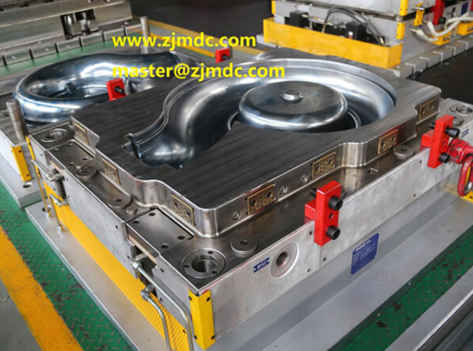
SMC PUMP MOLD
MDC
The materials of previous water pumps include cast iron, cast steel, bronze, stainless steel, carbon structural steel, alloy steel, etc. Most of them are made of steel, but although the water pumps made of this material have high strength and good compression resistance, Heavy weight, not easy to install. Because SMC materials are light, high-strength, not easy to corrode, and have a long service life, this advantage greatly compensates for the shortcomings of steel water pumps. In addition, the cost is relatively low, and SMC composite materials are gradually used to produce water pump moulds on the market.

Slide 16
SMC BATHROOM MOULD
MDC

Slide 17
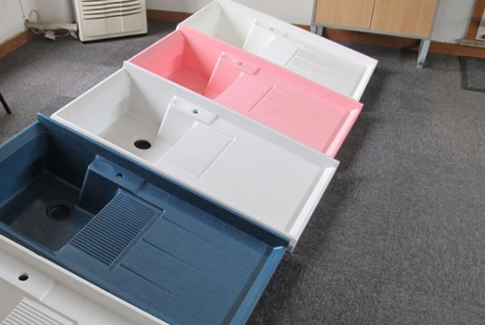
SMC LAUNDRY TROUGH MOLD
MDC
SMC laundry tank mold is not only relatively low cost, but also durable, not easy to rust, strong hardness and light quality, more and more become the choice of laundry tank production material.
MDC Mould is experienced in the manufacturing of SMC laundry trough mould.In addition to the laundry trough, in the shower room base mold, wash basin mold, bathtub mold is also very mature, have the demand please contact us!

Slide 18
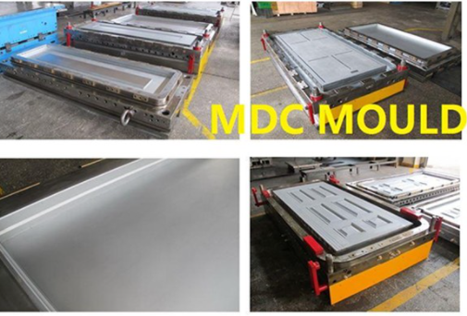
SMC DOOR SKIN MOULD
MDC
MDC has provided many kinds of SMC door mould, SMC door skin mould to the world market. This type of door mould is a large flat product, which is usually made by a moulding process. To produce the SMC door through the moulding process, or to mould the SMC door skin, you only need to place the SMC composite material in the cavity of the SMC mould and apply a certain pressure and temperature to obtain the product. MDC has many years of experience in the development of large-scale compression moulds. We have a press of up to 4000T, which can meet your needs for any door mould.

Slide 19
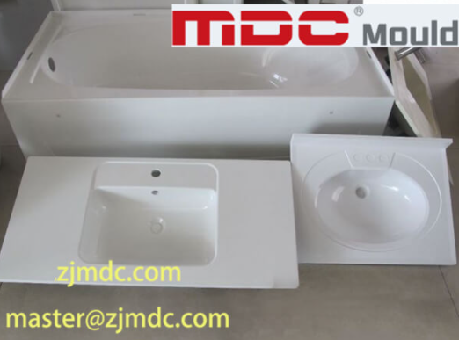
SMC SINK MOULD
MDC
MDC has top mould finishing technology and mould mirror polishing technology. We have multiple SMC sink mould production lines to ensure that your orders are completed on time and with high quality. For your SMC sink, we will help you achieve efficient production. In addition, with MDC's accumulated years of glass fibre reinforced plastic material technology, we ensure the service life, smoothness and use experience of your sink, and help you enhance your market competitiveness.

Slide 20
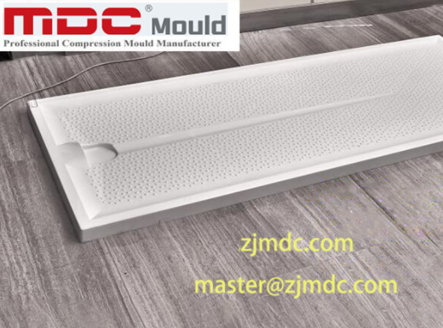
SMC SHOWER BASE MOULD
MDC
In the current market, the shower base is still using ceramics material or GRP material by hand layup technology. However, with new material development, MDC Mould have convinced their customers oversea to use SMC material instead of traditional ceramics technology. In the meanwhile, MDC Mould has been making this SMC shower base mould with different textures, and it becomes successful.
Performance characteristics of this shower base mould: 1. The surface is smooth, dense, skin-friendly, and easy to clean. 2. Thermal insulation, waterproof and moisture-proof. 3. Strong texture, impact resistance, high-temperature resistance, aging resistance and no moisture absorption. 4. It won't change color and deform when exposed to a hot and humid environment for a long time.

Slide 21
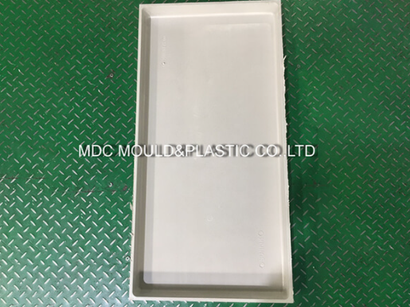
SMC WATER TANK MOULD
MDC
The raw material of the SMC water tank-resin sheet, the quality of the raw material plays a key role in the production of the SMC water tank. MDC has a press of up to 4000T, which can guarantee the density of the SMC water tank under this pressure, thereby ensuring the quality of the product. When the material block enters the cavity, the press moves down. When the upper and lower moulds coincide, slowly apply the required moulding pressure, and after a certain curing time, the moulding ends. During the moulding process, the moulding process parameters and press operating conditions should be selected reasonably.

Slide 22
SMC MEDICAL MOLD
MDC

Slide 23
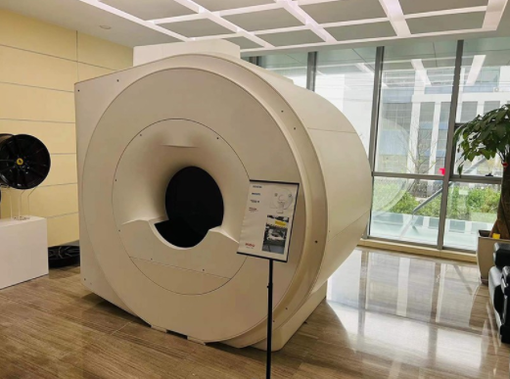
SMC MRI SHELL MOULD
MDC
Thermoplastic materials are widely used in MRI and CT equipment. However, thermoplastic materials also have some problems such as short service life and easy weathering. Because of its high strength, long service life and high cost performance, SMC medical molds have been widely used in the manufacture of MRI and CT scanner shells.
SMC moulding products generally have the advantages of rigidity, deformation resistance, large temperature range, lightweight and high strength. Therefore, NMR also began to widely used "SMC" mold, by everyone's welcome and recognition.

Slide 24
If you have an order, please contact our team！
MDC
Email: master@zjmdc.com
Tel: +86 576 84616076
Fax: +86 576 84616079
Mobile: +86 13906573507(Mr. Wang)
Address: No.35-1, Qingfeng Road, North Industrial Estate, HuangYan, Zhejiang,China.

